Slide 1
A Quadratic Approximation of the Wiener Path Integral for Stochastic Response Determination of Nonlinear Multi-degree-of-freedom Systems
Apostolos F. Psaros
Collaborators: Zhao Y., Petromichelakis I., Kougioumtzoglou I.
EMI / PMC 2021
Columbia University
May 25-28, 2021

Slide 2
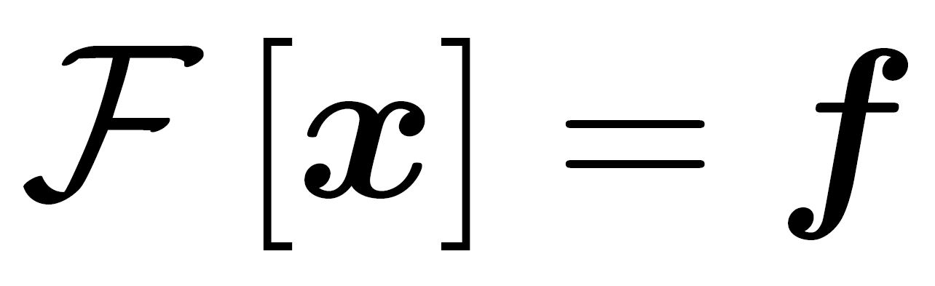

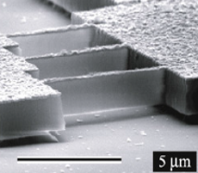


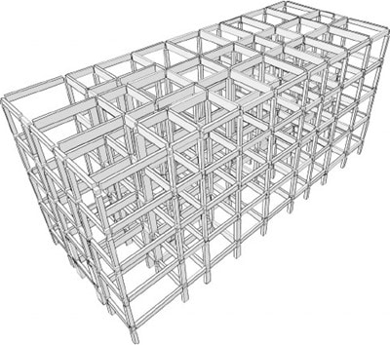
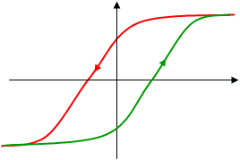
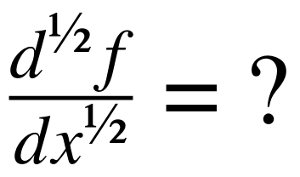
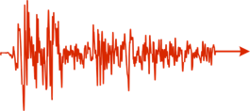
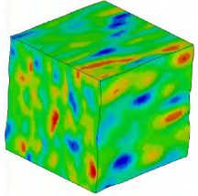
MOTIVATION: Stochasticity and complex system modeling
Diverse engineering mechanics & dynamics systems
Nanomechanical systems
(e.g., nano-resonators)
Vibratory energy harvesters
(e.g., piezoelectric devices)
Civil infrastructure systems
(e.g., bridges, maritime structures)
Common challenges in analysis & design
High dimensionality
Complex modeling
Stochasticity
Notes:
Irrespective of the scale of the problem and the type of engineering system, usual challenges in analysis and design pertain to high dimensionality, complex modeling involving nonlinearities and possibly fractional derivative terms, and stochasticity in the input or the system properties.

Slide 3
MOTIVATION: Stochasticity and complex system modeling
Diverse engineering mechanics & dynamics systems
Nanomechanical systems
Objective:
Uncertainty propagation
Vibratory energy harvesters
Analysis
Optimization
Design
Determining mean & variance is NOT enough
Probability density function (PDF)
Civil infrastructure systems
PDF
Low-probability
events
Response quantity
Notes:
In this regard, propagating this uncertainty to the system response is critical for robust analysis, design and optimization of a system.
However, due to the other two limitations, namely high dimensionality and complex modeling, most uncertainty propagation techniques provide only the first two moments of the response, which obviously cannot be used for addressing low probability events.
For such purposes, typically encountered in design of critical infrastructure and in reliability analysis, a complete specification of the stochastic response requires its joint probability density function (the PDF) for any time instant of interest.

Slide 4
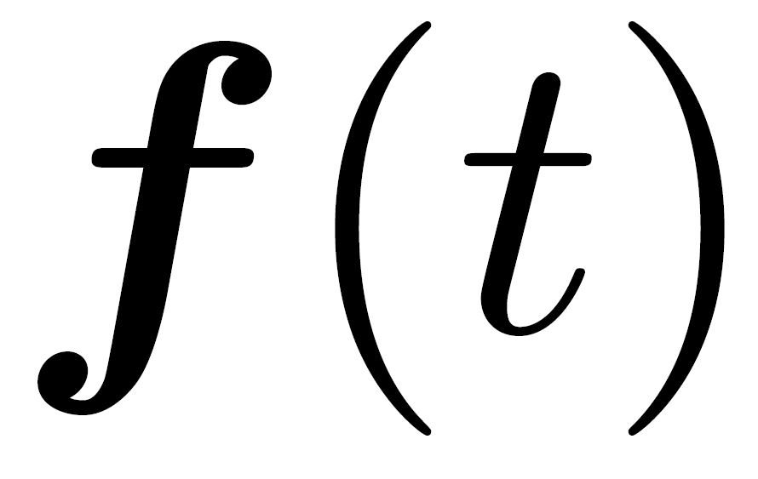
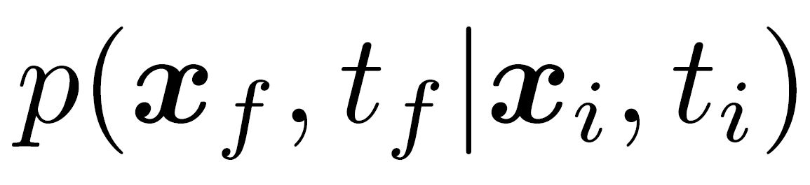
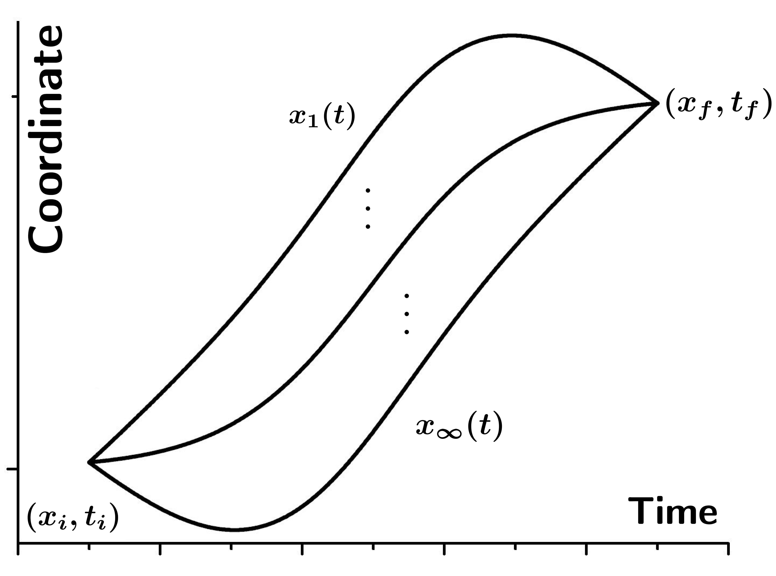
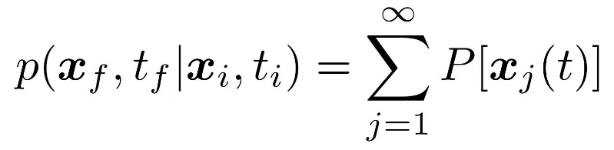
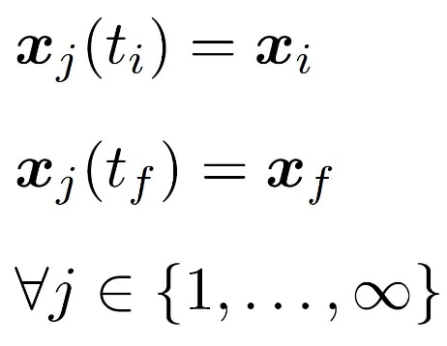
THE WIENER PATH INTEGRAL TECHNIQUE
Diverse engineering mechanics & dynamics systems
Non-stationary stochastic process:
Complete specification of response:
Sum of individual probabilities
External
excitation
Notes:
In this context the wiener path integral technique, originating from theoretical physics and recently adopted in engineering mechanics from Kougioumtzoglou and collaborators is one technique that provides the PDF of the response.
The technique is based on the idea that the probability for the response process x to start from a point xi at time ti and end up at some point xf at time tf can be expressed as the sum of the probabilities of all the possible paths that the process may take to get there.

Slide 5
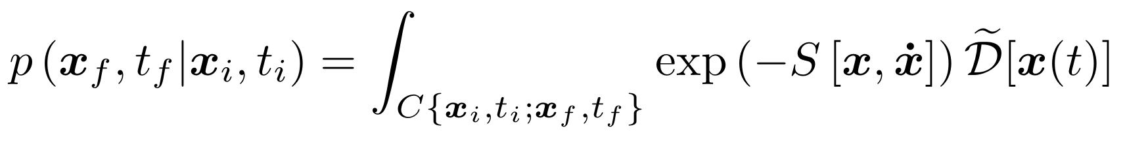



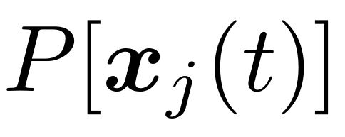
THE WIENER PATH INTEGRAL TECHNIQUE
Diverse engineering mechanics & dynamics systems
Non-stationary stochastic process:
Complete specification of response:
Sum of individual probabilities
: (loosely) the probability of each path
: stochastic action (a functional)
: functional measure of integration
External
excitation
Functional integral
Exact closed-form solutions for linear MDOF systems
Psaros et al. (2020), Prob Eng Mech
Notes:
Using a Gaussian transition probability for infinitesimally small time intervals and using the Markovian property of the process we can write the probability of each path with respect to the system properties, expressed here collectively with a functional denoted by capital S, typically called stochastic action, and then integrate for each intermediate time instant to obtain a multidimensional integral. This integral in the continuous limit can be written as a functional integral which is not possible to compute analytically except for certain classes of linear systems. For example, we were able to obtain exact closed form solutions of this integral for second order multi degree of freedom linear dynamical systems.

Slide 6
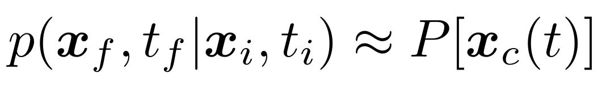

THE WIENER PATH INTEGRAL TECHNIQUE
Diverse engineering mechanics & dynamics systems
Non-stationary stochastic process:
Complete specification of response:
Sum of individual probabilities
: most probable path
External
excitation
Most probable path approximation
Notes:
Nevertheless, we are interested in practice in problems that are not amenable to an analytical solution treatment. For such cases an approximation of the functional integral can be obtained by considering only the most probable path. That is among all the possible paths the process may take we consider only the one with maximum probability of occurrence.
This probability depends on the starting and ending points, on the corresponding time instants and on the properties of the system through the stochastic action S.

Slide 7
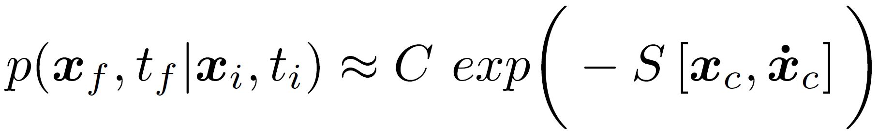
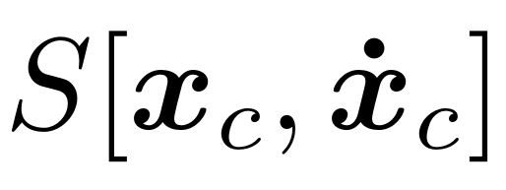
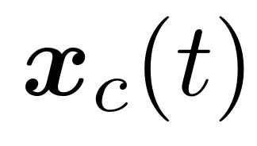

THE WIENER PATH INTEGRAL TECHNIQUE
Diverse engineering mechanics & dynamics systems
Non-stationary stochastic process:
Complete specification of response:
Sum of individual probabilities
: most probable path
: stochastic action on
: PDF normalization constant
External
excitation
Kougioumtzoglou & Spanos (2014), ASCE J Eng Mech
Non-white, non-Gaussian excitations
Psaros et al. (2018), J Sound & Vibration
Singular diffusion matrices
Petromichelakis et al. (2020), Prob Eng Mech
Energy harvesters w/ fractional derivatives
Petromichelakis et al. (2021), ASCE-ASME Risk & Uncer
Notes:
Based on this approximation Kougioumtozglou and Spanos in 2014 obtained approximate solutions for nonlinear dynamical systems subject to white gaussian noise. In the expression in the box C is a normalization constant that is computed after all the points of the PDF have been obtained.
In 2018 we extended the formulation to account for non white and non gaussian excitations, in 2020 to address singular diffusion matrices and more recently to analyze energy harvesters with fractional derivative elements.

Slide 8
THE WIENER PATH INTEGRAL TECHNIQUE
Diverse engineering mechanics & dynamics systems
Non-stationary stochastic process:
Complete specification of response:
Sum of individual probabilities
: most probable path
: stochastic action on
: PDF normalization constant
External
excitation
Kougioumtzoglou & Spanos (2014), ASCE J Eng Mech
Optimization problem to determine
Analytical solution for any final state is challenging
Solution for each final state separately
Notes:
Overall, for each point of the PDF which corresponds to a different final state, we have to solve one optimization problem to obtain the most probable path in order to approximate the complete PDF.

Slide 9
THE WIENER PATH INTEGRAL TECHNIQUE
Diverse engineering mechanics & dynamics systems
Non-stationary stochastic process:
Complete specification of response:
Sum of individual probabilities
External
excitation
Kougioumtzoglou & Spanos (2014), ASCE J Eng Mech
Sparsity and compressive sensing
Psaros et al. (2018), MSSP
Wavelets & numerical approximation
Psaros et al. (2019), MSSP
Bayesian compressive sensing
Katsidoniotaki et al., In preparation
Notes:
As you may have imagined already, because a separate problem has to be solved for each point of the domain, a line of work has focused on approximation schemes based on a few points only of the PDF. We have done that using compressive sensing, wavelets, positive definite functions, and we are now preparing a paper on Bayesian compressive sensing for this purpose.

Slide 10
THE WIENER PATH INTEGRAL TECHNIQUE: Accuracy
Functional series expansions and quadratic approximations for accuracy enhancement
Functional integral
x_{i}
x_{f}
t_{i}
t_{f}
Notes:
However, the work I will be sharing with you today concerns the accuracy of the technique and not its computational efficiency.
Recall that we have a separate functional integral for each final state and we approximate each one by using only the most probable paths (shown here with red lines).

Slide 11
THE WIENER PATH INTEGRAL TECHNIQUE: Accuracy
Functional series expansions and quadratic approximations for accuracy enhancement
Functional integral
x_{i}
x_{f}
t_{i}
t_{f}
Notes:
Therefore, enhancing the technique in terms of accuracy relates to including additional paths in our approximations, or in other words fluctuations around the most probable path.

Slide 12
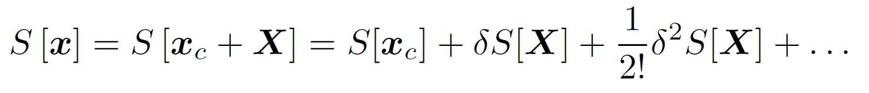
THE WIENER PATH INTEGRAL TECHNIQUE: Accuracy
Functional series expansions and quadratic approximations for accuracy enhancement
Functional integral
Notes:
For expressing this mathematically, we can expand the stochastic action in a Taylor-like manner, this is called functional series expansion, and work with the different orders separately.

Slide 13
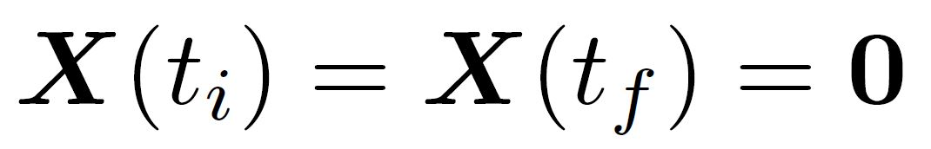
THE WIENER PATH INTEGRAL TECHNIQUE: Accuracy
Functional series expansions and quadratic approximations for accuracy enhancement
Functional integral
x_{i}
0
x_{f}
t_{i}
t_{f}
Notes:
Specifically, maximizing the probability of occurrence corresponds to minimizing the stochastic action at that point, which equivalently corresponds to making the first variation equal to zero.
Therefore, the most probable path approximation is essentially a zero-order approximation of the functional S.

Slide 14
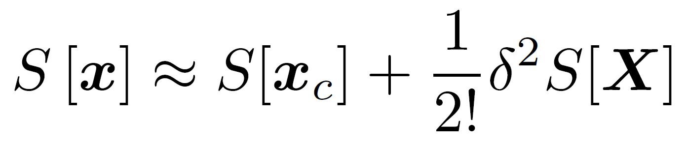
THE WIENER PATH INTEGRAL TECHNIQUE: Accuracy
Functional series expansions and quadratic approximations for accuracy enhancement
Functional integral
x_{i}
x_{f}
Zero initial/final conditions
t_{i}
t_{f}
Notes:
Next, a quadratic approximation simply means truncating the series and keeping only the zero- and the second-order terms.
The second order variation depends only on the difference of the most probable and the fluctuation paths, which for this reason has zero initial and final conditions and is denoted here by capital.

Slide 15
THE WIENER PATH INTEGRAL TECHNIQUE: Accuracy
Functional series expansions and quadratic approximations for accuracy enhancement
Functional integral
Zero initial/final conditions
Quadratic approximation
Notes:
Using the linearity of the stochastic action approximation and the fact that the stochastic action is in the exponent of the exponential in the functional integral, we can approximate the functional integral as a product of a factor phi that is itself a path integral on the fluctuations only and of the most probable path term which is simply the stochastic action evaluated at the most probable path.

Slide 16
THE WIENER PATH INTEGRAL TECHNIQUE: Accuracy
Functional series expansions and quadratic approximations for accuracy enhancement
Quadratic approximation
Kougioumtzoglou & Spanos (2014), ASCE J Eng Mech
state-independent
Notes:
To summarize, we have replaced the state-independent factor in front of the exponential with a state depended fluctuation factor which is itself a path integral, but this one in particular can be computed actually.

Slide 17
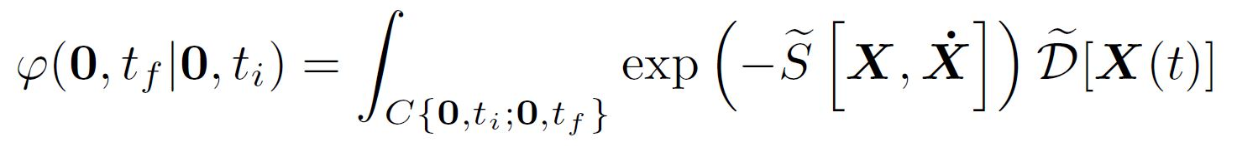
THE WIENER PATH INTEGRAL TECHNIQUE: Accuracy
Functional series expansions and quadratic approximations for accuracy enhancement
Quadratic approximation
Fluctuation factor
Notes:
So instead of the stochastic action in the original functional integral we now have the second variation of the action and instead of paths with initial and final conditions, we now have fluctuation paths with zero initial and final conditions.

Slide 18
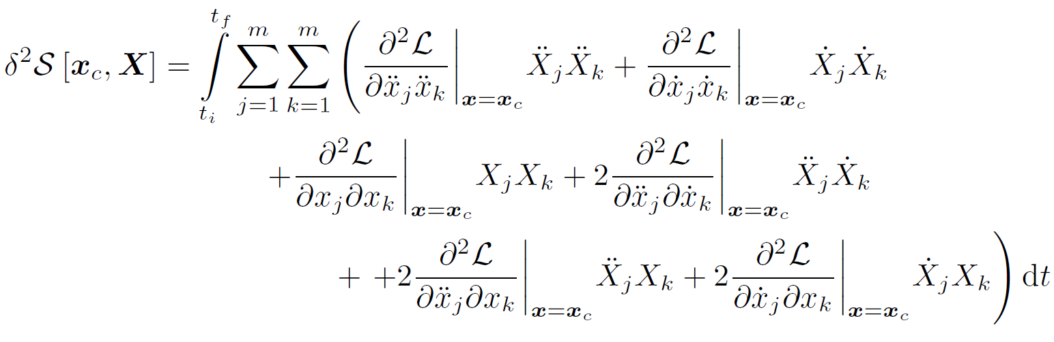
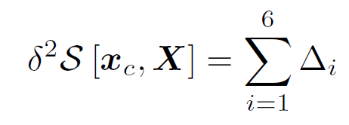
THE WIENER PATH INTEGRAL TECHNIQUE: Accuracy
Functional series expansions and quadratic approximations for accuracy enhancement
Notes:
I will now briefly go through the technique we use for approximating the fluctuation factor.
From calculus of variations we obtain the second order variation for a specific fluctuation path capital X as an integral of the second order derivatives of the Lagrangian evaluated at the most probable path, times the corresponding derivatives of the fluctuation path.
In a more compact form this is a sum of 6 different terms denoted here with Delta i.

Slide 19
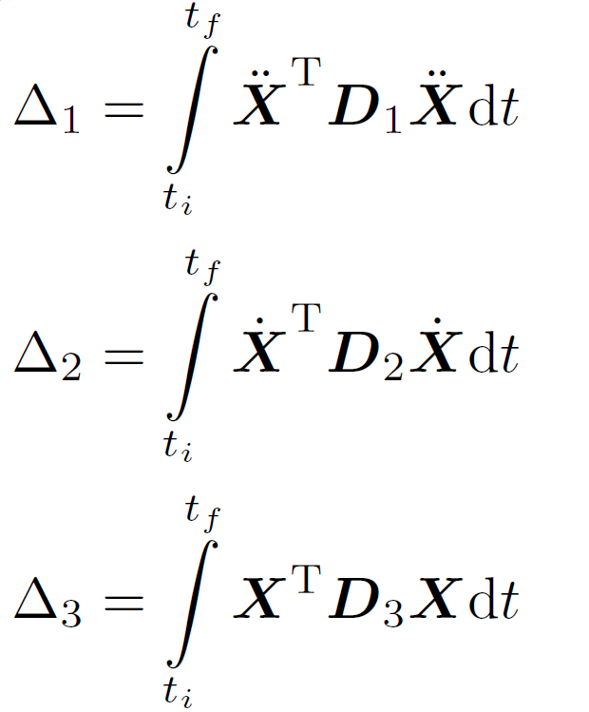
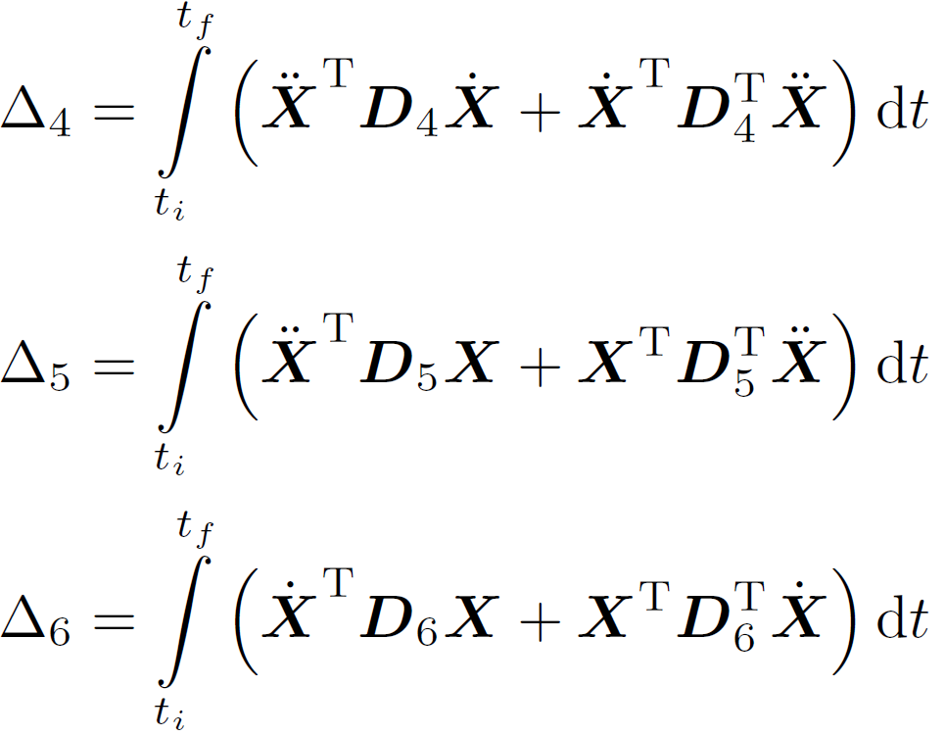
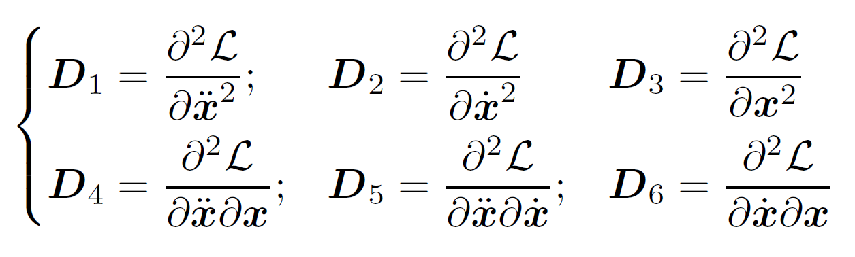
THE WIENER PATH INTEGRAL TECHNIQUE: Accuracy
Functional series expansions and quadratic approximations for accuracy enhancement
Notes:
And each delta I is a separate integral which already starts resembling an integral involving quadratic forms with the exception that we have different orders of derivatives to the left and to the right of the functionals D one to six.

Slide 20
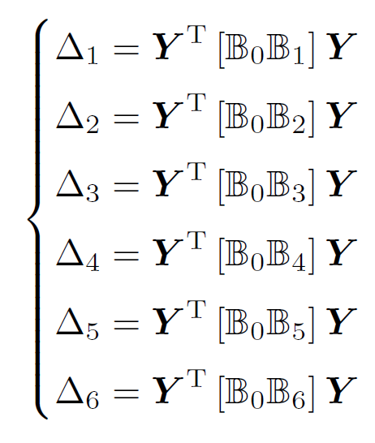
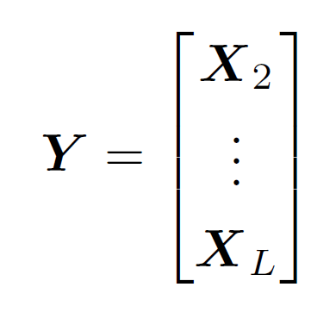
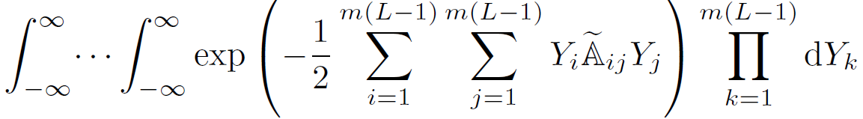
THE WIENER PATH INTEGRAL TECHNIQUE: Accuracy
Functional series expansions and quadratic approximations for accuracy enhancement
Notes:
Next, by discretizing the time domain we can approximate the Delta expressions with actual quadratic forms with matrices B that are the expressions D of the previous slide evaluated on the most probable path and with vectors Y that correspond to discretized versions of the fluctuation paths.
Substituting these back to the discretized form of the functional integral, which remember is a multidimensional integral, we obtain this expression. Fortunately, this is in fact a Gaussian multidimensional integral and we have an analytical solution that depends on the determinant of the matrix A that is constructed by using the submatrices Aij.
Therefore, for obtaining the fluctuation factor we only need to compute numerically the determinant of a matrix.

Slide 21
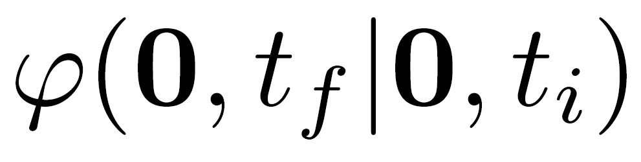
THE WIENER PATH INTEGRAL TECHNIQUE: Accuracy
Functional series expansions and quadratic approximations for accuracy enhancement
Quadratic approximation
Fluctuation factor
Determine for every PDF point
By using determine for every PDF point
Obtain a quadratic approximation of the PDF
PDF normalization step is circumvented
Low probability events estimated with only a few PDF points
Notes:
Overall, to obtain the PDF value of a given point, we determine the most probable path xc, then we compute the fluctuation factor and then the quadratic approximation of the PDF is readily available.
This way, we avoid the normalization step of the PDF because we already have the fluctuation factor that works also as a normalization state dependent factor, and we can directly calculate low probability events without having to obtain the PDF at every point first.

Slide 22
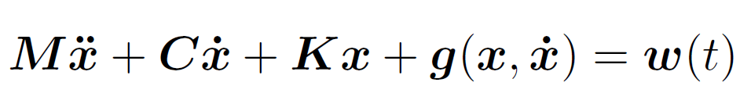
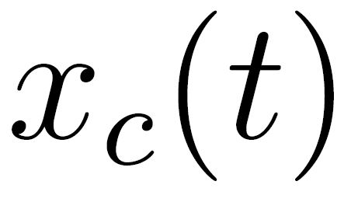
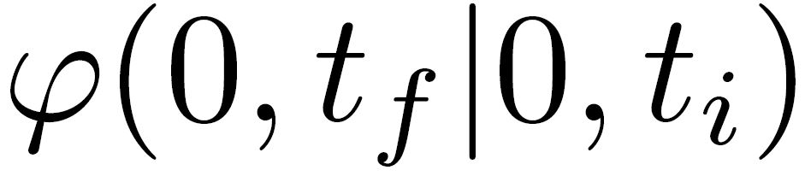
THE WIENER PATH INTEGRAL TECHNIQUE: Accuracy
Functional series expansions and quadratic approximations for accuracy enhancement
Numerical example:
2-DOF nonlinear oscillator
Discretize effective domain
Determine and
Quadratic approximation:
Notes:
As a numerical example we consider a 2-dof nonlinear oscillator with an asymmetric response PDF. This is due to the x squared nonlinearities in the function g.
For obtaining the PDF at every point we discretize the domain, obtain the most probable path and the fluctuation factor at every points and then compute the PDF values as a product of the two terms.

Slide 23
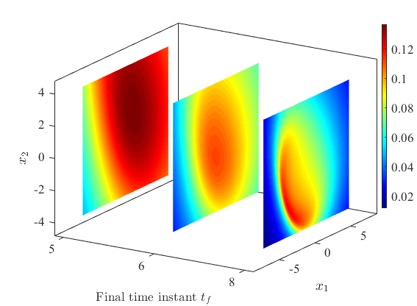
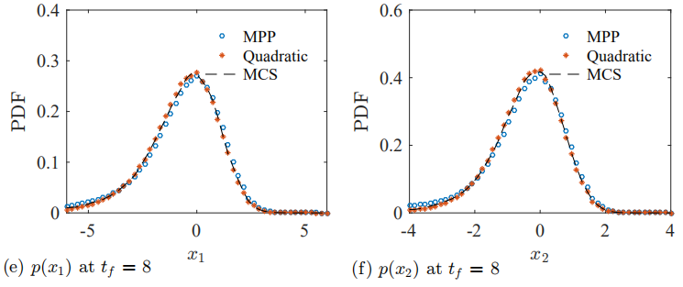
THE WIENER PATH INTEGRAL TECHNIQUE: Accuracy
Functional series expansions and quadratic approximations for accuracy enhancement
Numerical example:
2-DOF nonlinear oscillator
Notes:
On the left you can see the fluctuation factor at 3 time instants. Because we have 4 dimensions, that is 2 displacements and 2 velocities, for visualization purposes we show the fluctuation factor for varying displacements but for fixed velocities. On the right you can see the marginal PDFs of x1 and x2 at a given time instant. You can see that the quadratic approximation for this problem is much better than most probable path as compared with monte carlo simulation, but you’ll see in the next slide more quantitative results of this fact.

Slide 24
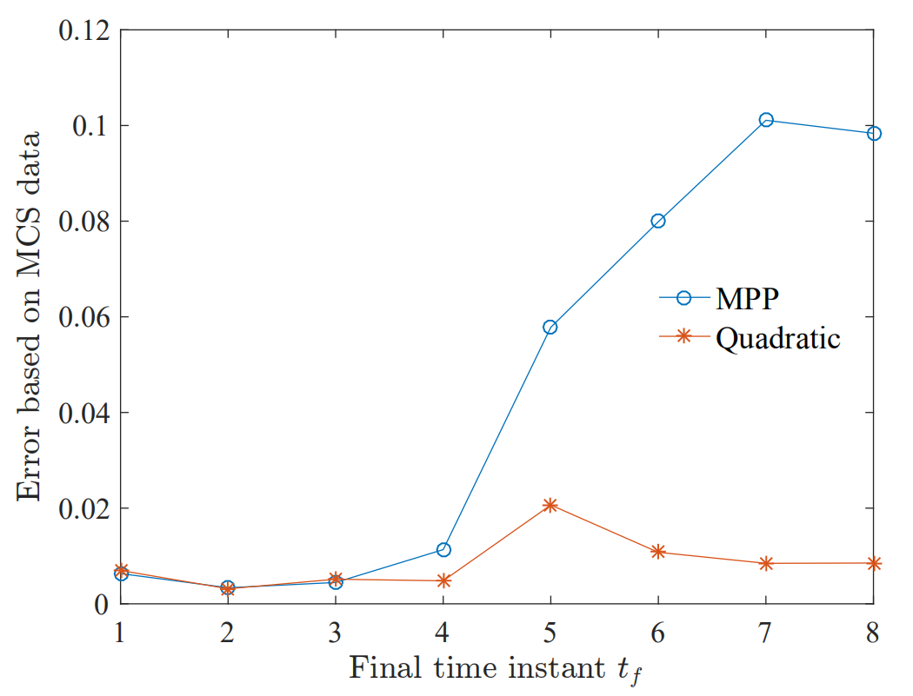
THE WIENER PATH INTEGRAL TECHNIQUE: Accuracy
Functional series expansions and quadratic approximations for accuracy enhancement
Numerical example:
2-DOF nonlinear oscillator
Notes:
Specifically, the error of most probable path although the same with the quadratic approximation error at early time instants, seems to increase significantly after time instant 4 seconds. On the other hand the relative error of the quadratic approximation stays always below 2 percent for this example.

Slide 25
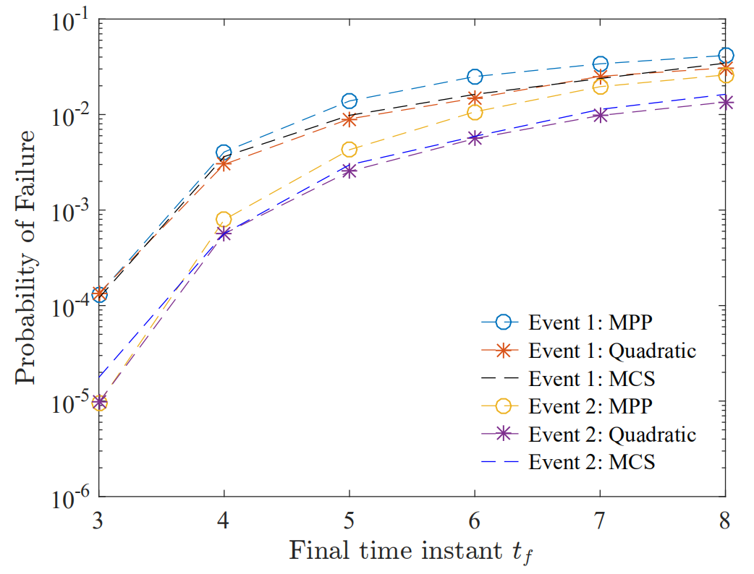
THE WIENER PATH INTEGRAL TECHNIQUE: Accuracy
Functional series expansions and quadratic approximations for accuracy enhancement
Numerical example:
2-DOF nonlinear oscillator
Notes:
Finally, we can use the technique for estimating low probability events. The top and the bottom lines correspond to two different events, say for example x greater than 1. As you can see the quadratic approximation estimates for these events is much more accurate than the most probable path estimates, a fact that makes this accuracy enhancement especially significant for approximating the tails of the response PDF.

Slide 26
SUMMARY
Diverse engineering mechanics & dynamics systems
The Wiener path integral technique – Limitations
Optimization problem to determine
Analytical solution for any final state is challenging
Solution for each final state separately
Notes:
In summary, we started with the wiener path integral technique, we showed that an approximation of the PDF can be obtained by the most probable path approximation, and for obtaining the most probable path we have to solve an optimization problem for each point of the PDF.

Slide 27
SUMMARY
Diverse engineering mechanics & dynamics systems
The Wiener path integral technique – Limitations
Accuracy: Functional series expansions & quadratic approximations
x_{i}
x_{f}
t_{i}
t_{f}
Notes:
Then we talked about enhancing the accuracy of the technique by considering fluctuation paths around the most probable path.
Mathematically, this takes the form of a series expansion and an additional path integral which is in fact computable numerically because the fluctuations have zero initial and final conditions.

Slide 28
SUMMARY
Diverse engineering mechanics & dynamics systems
The Wiener path integral technique – Limitations
Accuracy: Functional series expansions & quadratic approximations
PDF normalization step is circumvented
Low probability events estimated with only a few PDF points
Notes:
We showed with a numerical example that the accuracy is enhanced significantly especially for large time instants, while at the same time low probability events can be estimated using only a few points of the PDF because the normalization step is circumvented.

Slide 29
A Quadratic Approximation of the Wiener Path Integral for Stochastic Response Determination of Nonlinear Multi-degree-of-freedom Systems
Apostolos F. Psaros
Collaborators: Zhao Y., Petromichelakis I., Kougioumtzoglou I.
EMI / PMC 2021
Columbia University
May 25-28, 2021
THANK YOU!
Notes:
Thanks a lot for your attention and I’d be happy to take any questions you may have.

